Slide 1
Factors of Safety and Reliability
CE 544 – BRIGHAM YOUNG UNIVERSITY
Notes:
From Duncan and Wright, Chapter 13

Slide 2
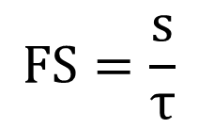
Factor of Safety
Traditional definition:
$$FS=\frac{s}{τ}$$
S = shear strength of soil
τ = shear stress required for equilibrium
But what does that mean in practice? What does F=1.3 mean?
Notes:
F=1.01 would be fine if we had complete certainty in our analysis
The most uncertain part of analysis is shear strength – so we can say that F=1.3 means that we can reduce S by 30% and still be OK.

Slide 3
What value of FS is acceptable?
 | Uncertainty of Analysis Conditions
Cost and consequence of failure | Small | High
Cost of repair comparable to cost of building more conservative slope | 1.25 | 1.5
Cost of repair much greater than cost of building more conservative slope | 1.5 | 2.0+
 | Required Factors of Safety
Types of slopes | End of Construction | Long-Term Steady Seepage | Rapid Drawdown
Slopes of dams, levees, dikes, and other embankment and excavation types | 1.3 | 1.5 | 1.0-1.2
US Army Corps of Engineers Slope Stability Manual
Notes:
Guidelines like this should only be used when the methods of site testing, analysis, etc. are consistent from one project to the other.

Slide 4
Reliability and Probability of Failure
Alternative measure of analyzing stability
Reliability = the probability that the slope will perform as designed and not fail over the life of the project
R = 1 - P_{f}
Where:
R = Reliability
P_{f} = Probability of failure
Notes:
Talk about impact of using reliablity vs factor of safety. Public/clients sometimes don’t want to know that there is some probability of failure.

Slide 5
Reliability and Uncertainty
In order to determine reliability, we need to understand the uncertainty in each of the input parameters.
Primary uncertainty relates to shear strength (c, φ), but there may be a range of uncertainty in other parameters also (γ, u, etc.)
Uncertainty is typically represented by standard deviation (σ) or coefficient of variation (COV)

Slide 6
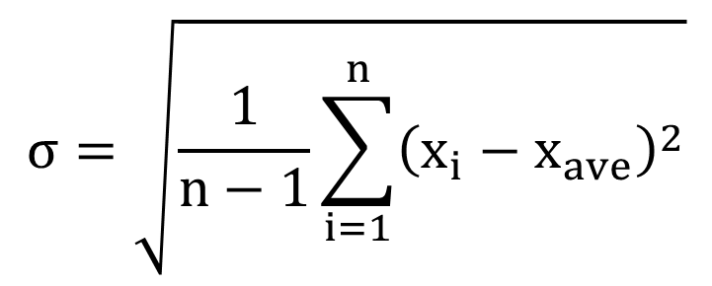
Standard Deviation
$$σ=\sqrt{\frac{1}{n−1}\sum_{i=1}^{n}{{\left(x_{i}−x_{ave}\right)}^{2}}}$$
Where:
n = number of samples
x_{i} = individual sample values
x_{ave} = average sample value

Slide 7
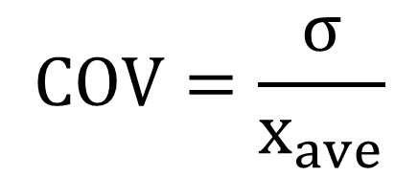
Coefficient of Variation
$$COV=\frac{σ}{x_{ave}}$$
Typically expressed as a percentage (Ex. 0.23 → 23%)
See spreadsheet for sample calculations

Slide 8
Frequency Histogram
Mean = 400, σ = 100, N = 200

Slide 9
Frequency Histogram
If we have enough samples, we can calculate the mean and standard deviation directly from our dataset.
However, we rarely have enough samples to adequately characterize the mean and standard deviation with confidence. Therefore, we typically infer the values using one of the methods in the following slides
σ
Mean
Freq.
Parameter Value

Slide 10
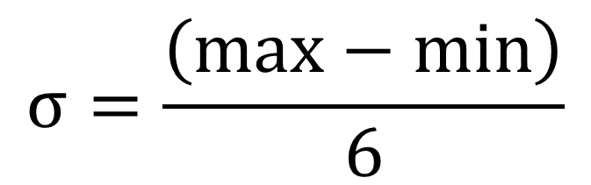
3σ Rule
99.7% of all values fall within +/- 3 standard deviations
If you can estimate the max and min expected values, you can estimate the standard deviation as:
$$σ=\frac{\left(max−min\right)}{6}$$

Slide 11
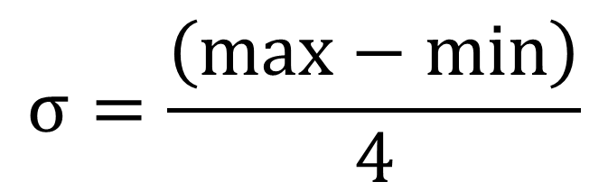
3σ Rule, cont.
Studies have shown that even experts often under-estimate max and min values (estimated range is typically too small)
Thus, it is conservative to estimate the standard deviation as:
$$σ=\frac{\left(max−min\right)}{4}$$
See in-class exercise for sample calculations

Slide 12
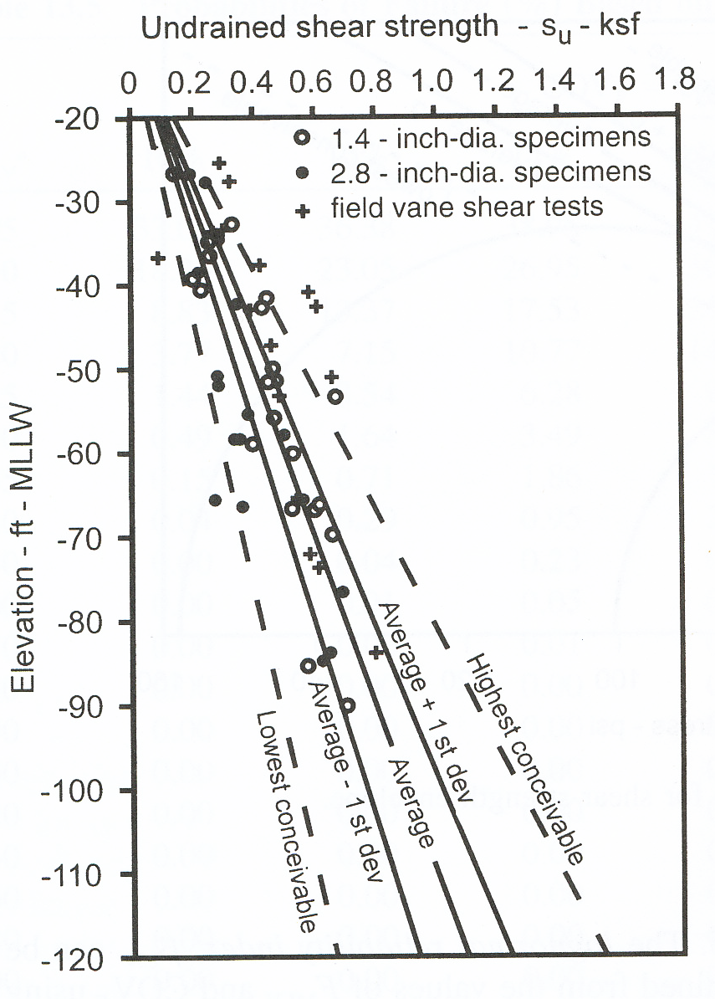
Graphical Method
Steps:
Draw average line
Draw max and min line
Draw +/- σ lines assuming 3σ rule (or 2σ to be conservative)
Notes:
Figure 13.1 Example of graphical 3sigma rule for undrained strength profile.

Slide 13
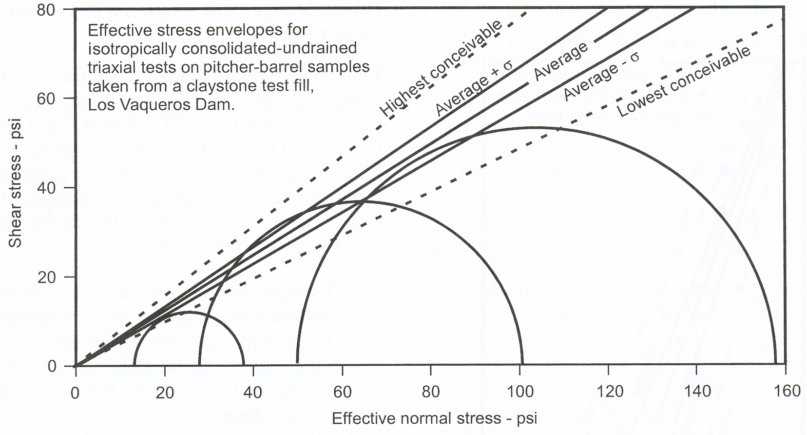
Graphical Method
Notes:
Figure 13.2 Example of graphical 3sigma rule for shear strength envelope.

Slide 14
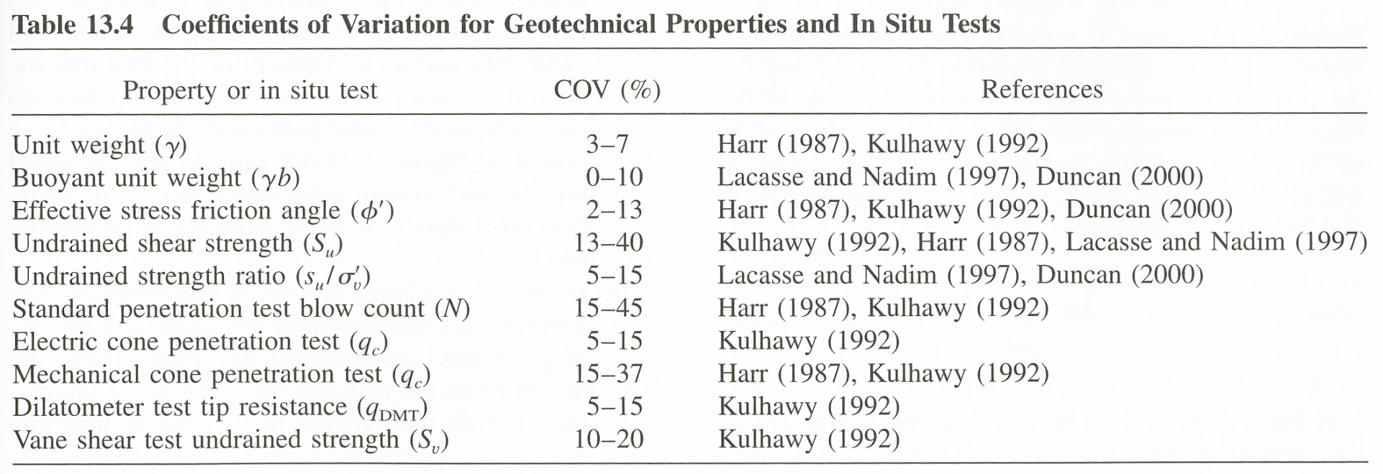
Typical COV Ranges

Slide 15
Reliability Analysis

Slide 16
Determining Reliability
Overall reliability can be determined once we know the following values:
F_{MLV} = Factor of safety for slope using most likely values (averages)
COV_{F} = Coefficient of variation for factor of safety
We typically assume that F is log-normally distributed

Slide 17
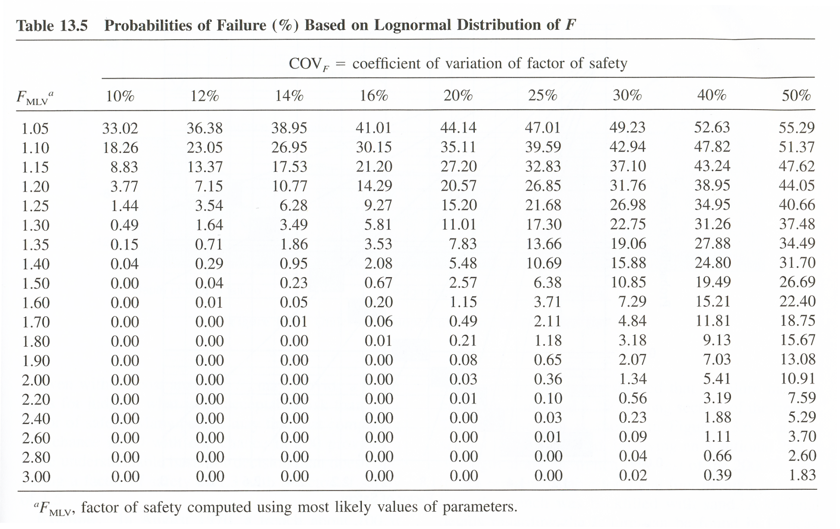
Probability of Failure vs F_{MLV}, COV_{F}

Slide 18
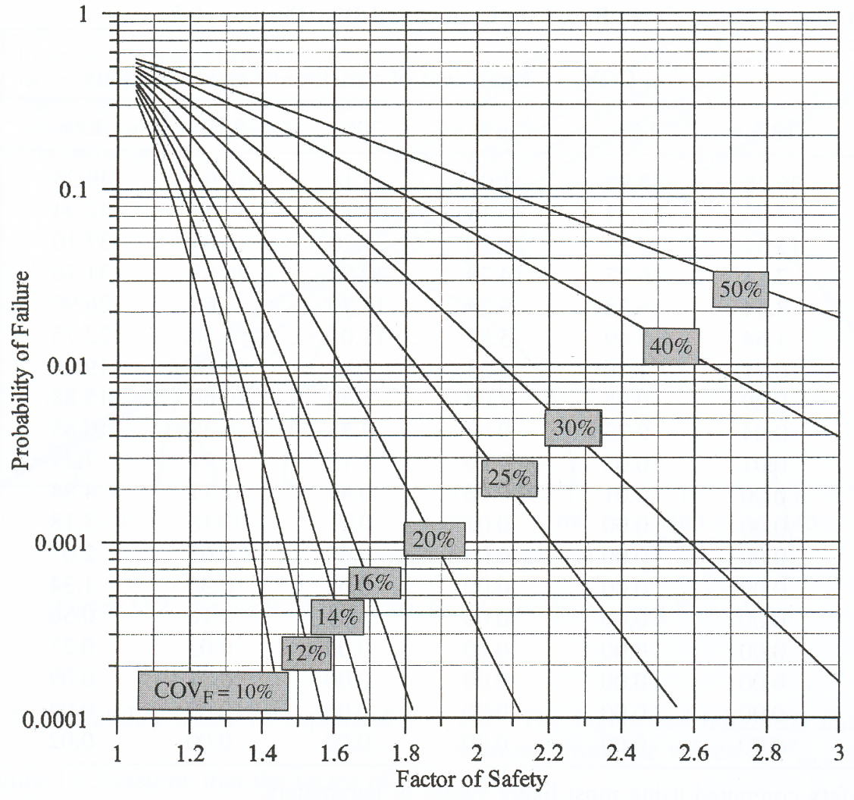
Probability of Failure vs F_{MLV}, COV_{F}
(same as previous table)
Notes:
Figure 13.3 Probabilities of failure based on lognormal distribution of F.

Slide 19
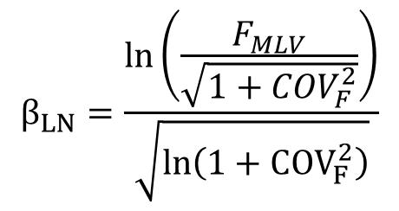
Reliability Equation
Values in previous table and figure can be found using equations.
Reliability index (β) = Number of standard deviations between F_{MLV} and verge of failure (F=1).
Lognormal Reliability Index:
$$β_{LN}=\frac{ln\left(\frac{F_{MLV}}{\sqrt{1+{COV}_{F}^{2}}}\right)}{\sqrt{ln\left(1+COV_{F}^{2}\right)}}$$
You can then use β_{LN} as in input argument to the Excel function NORMSDIST() to compute the reliability.
R=NORMSDIST(β_{LN})

Slide 20
Determining Reliability
F_{MLV} is found using conventional slope stability analysis
In order to determine reliability, we need to find COV_{F}
Two common approaches:
Monte Carlo Method
Taylor Series Method

Slide 21
Monte Carlo Method
Generate N equally likely model “instances” or “realizations” by randomizing model parameters in a systematic fashion
Run all N models and calculate F for each model
Calculate COV_{F}

Slide 22
Parameter Randomization
# | c | φ | γ
1 | 235 | 21.4 | 118.3
2 | 241 | 23.7 | 115.9
3 | 276 | 28.2 | 117.8
4 | 199 | 25.0 | 123.6
5 | 212 | 25.8 | 121.0
6 | 205 | 27.3 | 115.7
7 | 249 | 23.7 | 113.8
8 | 251 | 19.9 | 119.2
9 | 225 | 27.1 | 116.7
10 | 299 | 26.1 | 112.7
11 | 189 | 24.4 | 120.3
c
φ
γ

Slide 23
Standard Deviation
# | c | φ | γ | F
1 | 235 | 21.4 | 118 | 1.42
2 | 241 | 23.7 | 116 | 1.28
3 | 276 | 28.2 | 118 | 1.17
4 | 199 | 25 | 124 | 1.05
5 | 212 | 25.8 | 121 | 0.89
6 | 205 | 27.3 | 116 | 1.23
7 | 249 | 23.7 | 114 | 1.04
8 | 251 | 19.9 | 119 | 1.19
9 | 225 | 27.1 | 117 | 1.30
10 | 299 | 26.1 | 113 | 1.10
11 | 189 | 24.4 | 120 | 0.95
Mean F = 1.15
σ_{F} = 0.159
COV_{F} = 0.159/1.15 = 13.9%
How many runs are required?
Ideally, you would do enough model runs to achieve “statistical convergence”; i.e., the point at which doing additional model runs only makes a minor difference in the mean F.

Slide 24
Taylor Series Method
Method for estimating the COV_{F} using a parameter sensitivity analysis
Steps:
Determine σ_{i} for each parameter
Find F_{i}⁺ and F_{i}⁻ for each parameter where
F_{i}⁺ = F with parameter value = MLV+ σ_{i} and all other parameters held constant
F_{i}⁻ = F with parameter value = MLV- σ_{i} and all other parameters held constant
Compute ΔF_{i} = |F_{i}⁺ - F_{i}⁻| for each parameter

Slide 25
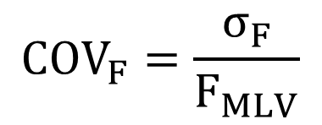
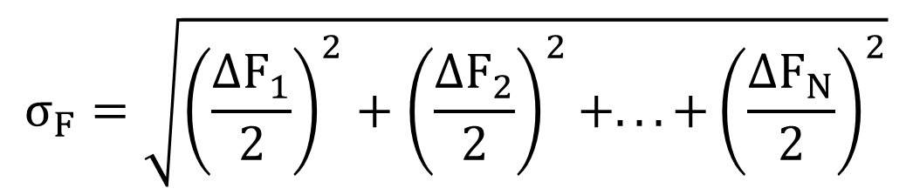
Taylor Series Method, cont.
Compute σ_{F} and COV_{F} as follows:
$$σ_{F}=\sqrt{{\left(\frac{ΔF_{1}}{2}\right)}^{2}+{\left(\frac{ΔF_{2}}{2}\right)}^{2}+...+{\left(\frac{ΔF_{N}}{2}\right)}^{2}}$$
$$COV_{F}=\frac{σ_{F}}{F_{MLV}}$$

Slide 26
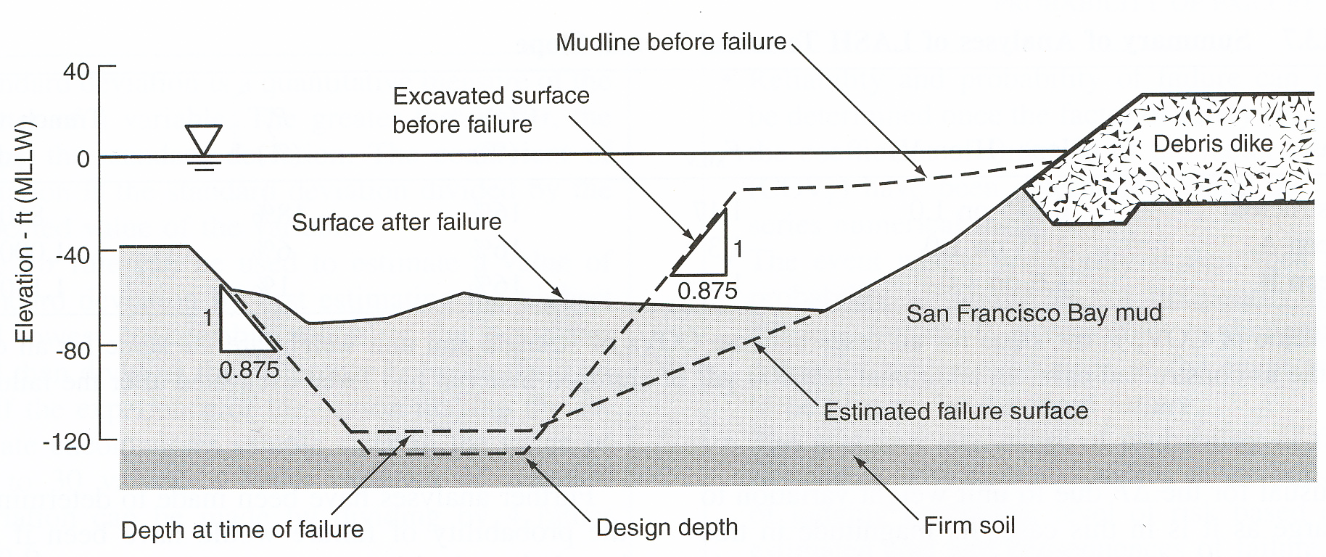
Case Study – San Francisco LASH Terminal (1970)
Failure occurred over a 250 ft long stretch of trench during excavation.

Slide 27
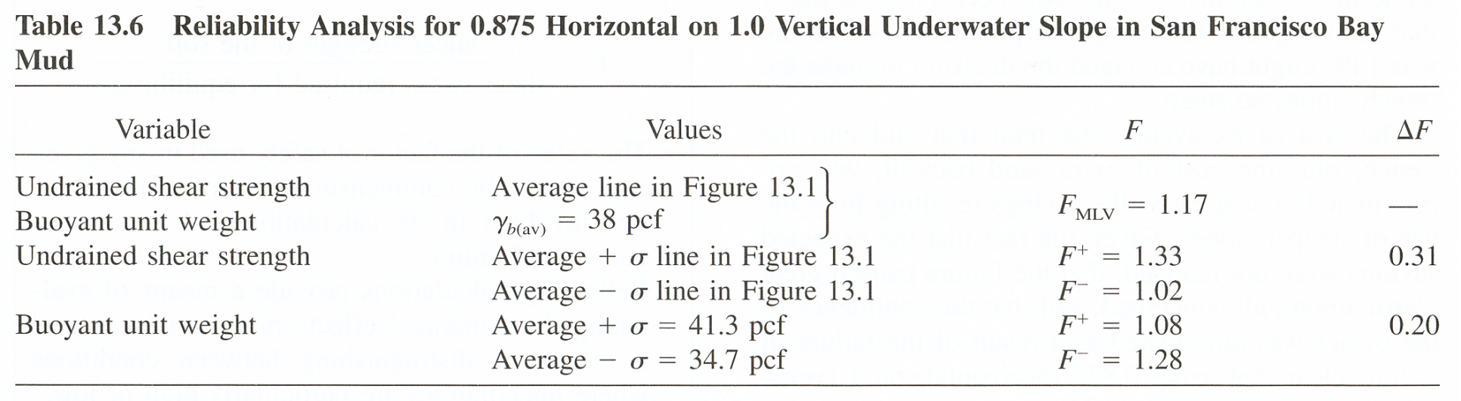
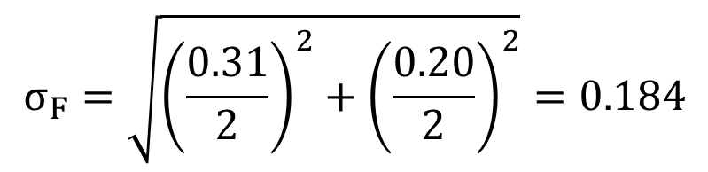
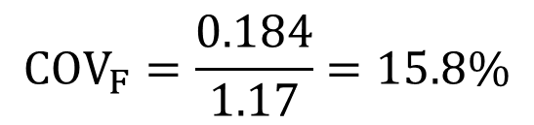
LASH Terminal, cont.
$$σ_{F}=\sqrt{{\left(\frac{0.31}{2}\right)}^{2}+{\left(\frac{0.20}{2}\right)}^{2}}=0.184$$
See spreadsheet for reliability calculations
$$COV_{F}=\frac{0.184}{1.17}=15.8\%$$

Slide 28
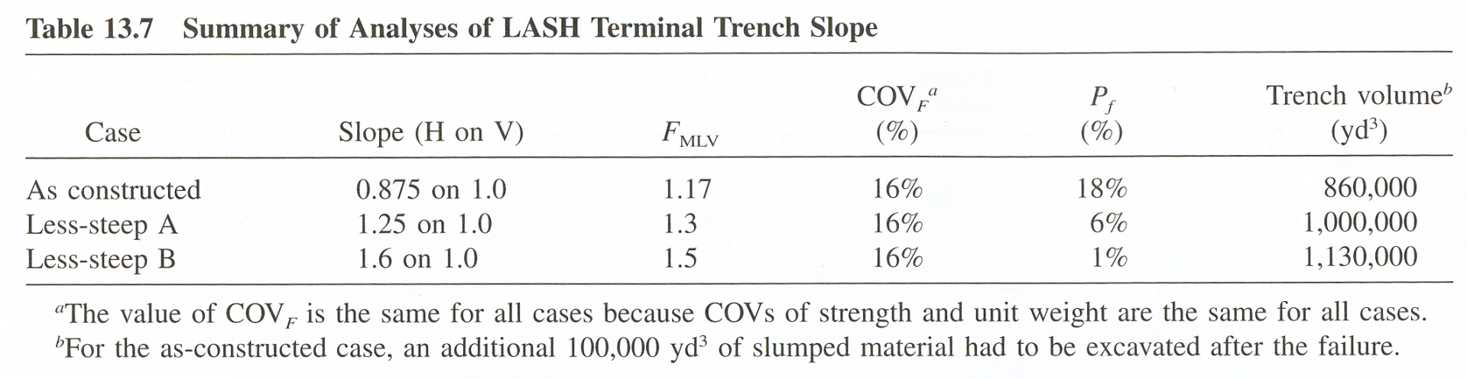
Alternative Designs

